Slide 1
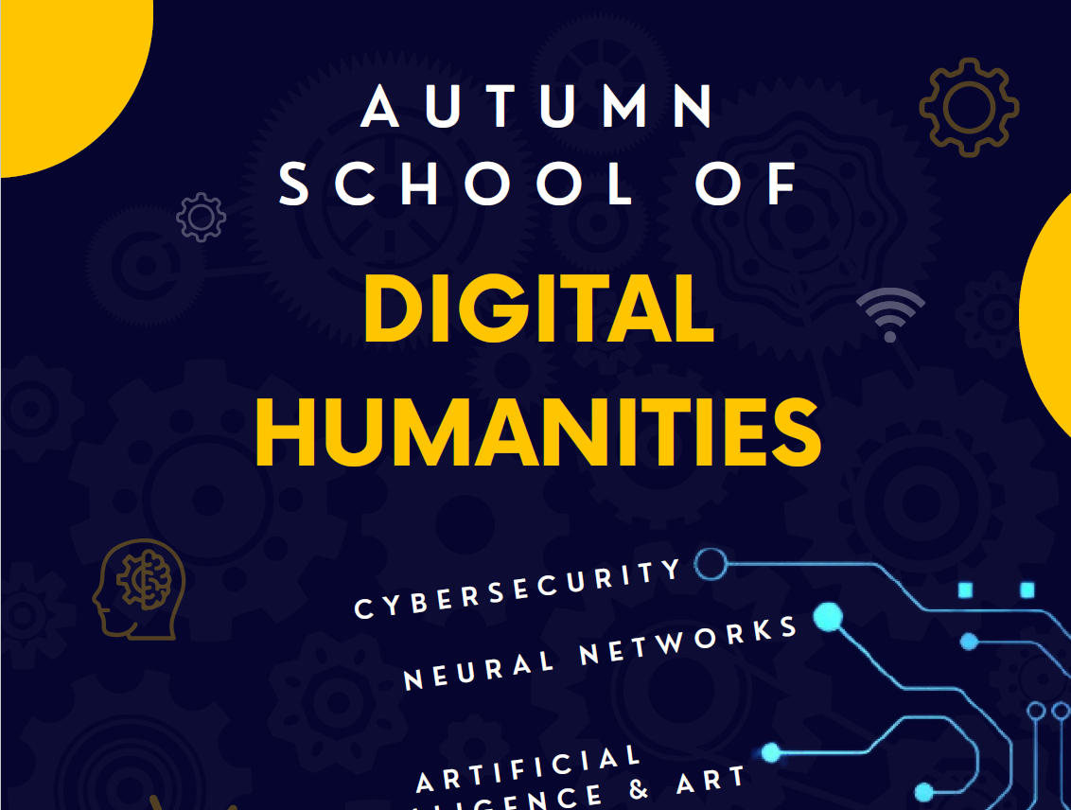

Slide 2
The role of metadata in digital information retrieval
Dr Dorota Siwecka
Institute of Informationa and Media Studies
University of Wrocław

Slide 3
Plan
Purpouse of Metadata
Controlled vocabulary, free keywords and folksonomy
Library catalogues and bibliographies vs. discovery services and other search engines
Searching strategies
Examples
Using metadata in bibliography managers

Slide 4
1. Purpouse of Metadata
Resource identification and description
Retrieving information
Managing information
Managing intellectual property rights
Supporting e-commerce and e-government
Information governance
Haynes, D. (2018). Metadata for Information Management and Retrieval: Understanding metadata and its use. Facet. https://doi.org/10.29085/9781783302161
Notes:
Resource identification and description
„primary purpose of which is to facilitate information access and use”
“to describe a resource is a representation of that resource”
Retrieving information – bez metadanych możliwe byłoby jeszcze wyszukiwanie dokumentów tekstowych (specjalne algorytmy mogą przeszukiwać treści dokumentów), natomiast nadal problelmem jest indeksacja materiałów graficznych i audiowizualnych, które wymagają ingerencji człowieka w trakcie indkesowania
Managing information
Managing intellectual property rights
Supporting e-commerce and e-government
Information governance

Slide 5
2. Controlled vocabulary, free keywords and folksonomy
Controlled vocabulary
Dictionaries, classification scheme, thesauri…
LCSH, UDC, DBN, RAMEAU
Keywords and folksonomy
Free to use
From useres, authors, publishers…
Polisemy, synonymia
Subject headings, classifications, descriptors
Cataloguers
Highquality of metadata?
Quality of metadata?
Google Scholar, Instagram…
Notes:
finite number of words that we can use to describe resources in a data base
Those words can be found in dictionaires, thesauri
Dictionaires – list of words that you can use in a data base to provide information about subject or form of documents
BT – broader term; NT – narrower term, USE – use this not that; UF- Used for
Polisemy/homonimia – 1 word that has more than 1 meaning: Typickým příkladem polysémie je slovo oko; významem tohoto slova může být:
Zrakový orgán
Pytlácká past
Otvor na punčoše
Skvrna v polévce
ManThe human species (i.e., man vs. other organisms)
Males of the human species (i.e., man vs. woman)
Adult males of the human species (i.e., man vs. boy)

Slide 6
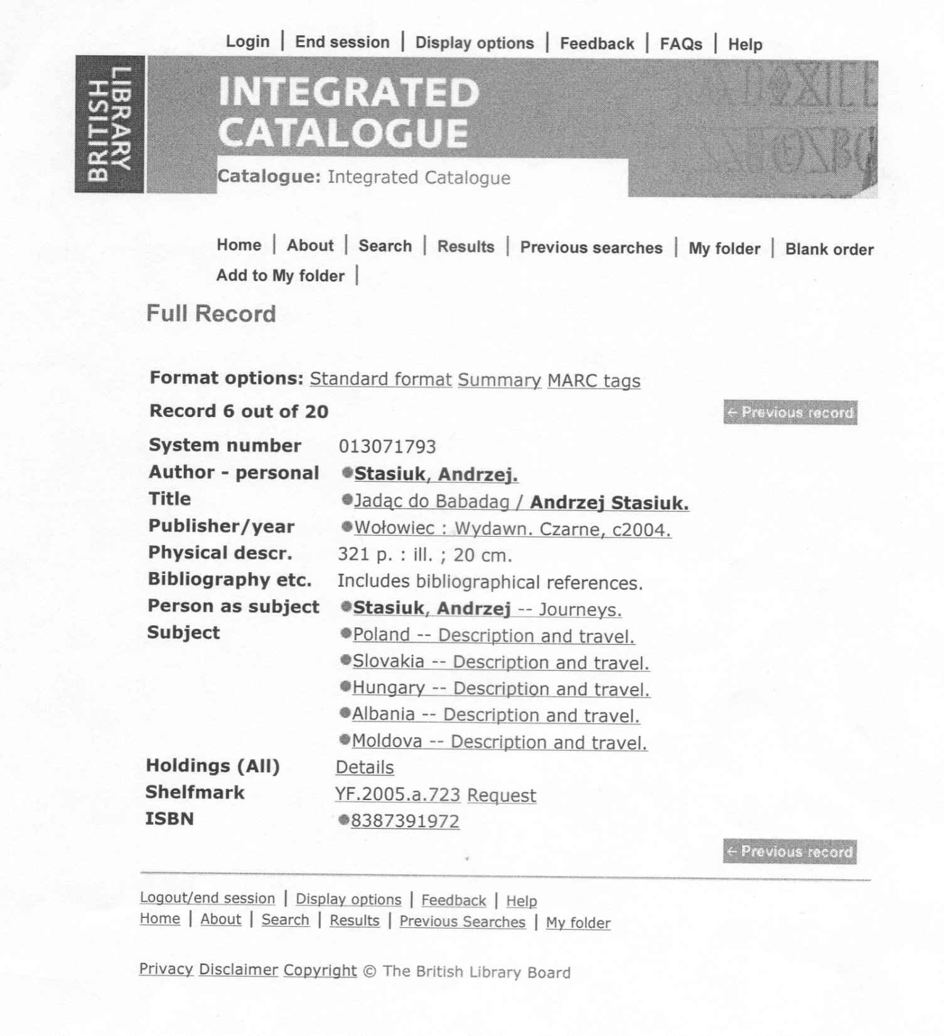
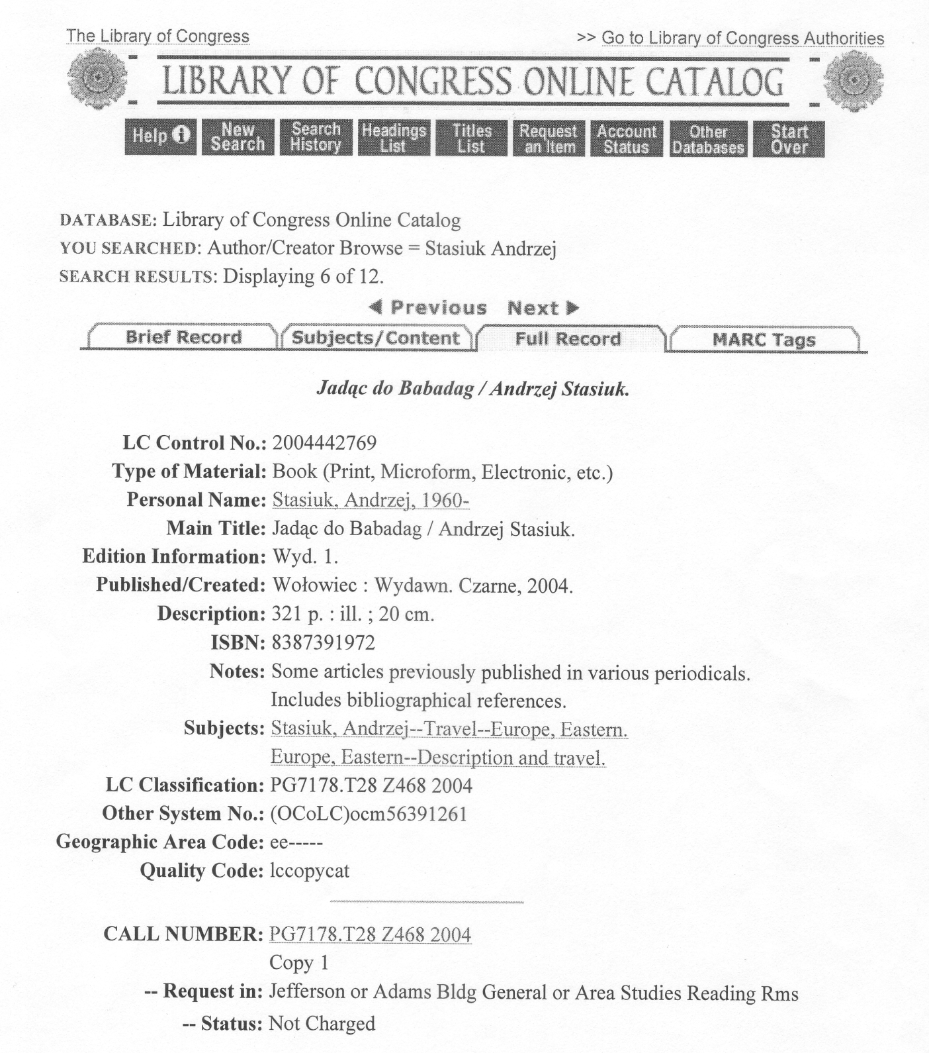
Subject headings
Stasiuk, Andrzej (1960-....) Sur la route de Babadag [Texte imprimé] / Andrzej Stasiuk ; traduit du polonais par Małgorzata Maliszewska. - [Paris] : C. Bourgois, DL 2007 (61-Lonrai : Normandie roto impr.) - 1 vol. (363 p.) : couv. ill. ; 20 cm. Titre original : Jadąc do Babadag. - DLE-20070222-9662. - 914.045 6 (21) . - ISBN 978-2-267-01904-9 (br.) : 26 EUR. - EAN 9782267019049. Europe centrale -- Descriptions et voyages -- 1990-.... Balkans -- Descriptions et voyages -- 1990-.... BN 40986214 07-12085
Notes:
6

Slide 7
Słowa kluczowe
man, see, pyramid, hill, telescope
[Za: A. Vickery, B. Vickery, Information Science in Theory and Practice, 3 Aufl., Muenchen : Saur, 2004]
Notes:
Za: Alina Vickery, Brian Vickery, Information Science in Theory and Practice. 3 Aufl., Muenchen : Saur, 2004.
7

Slide 8
Słowa kluczowe
Notes:
Natural language is highly ambiguous and must be disambiguated.

Slide 9
Keywords from authors
Empathy of men and women experiencing a sense of exclusion in a close relationship: Gender as moderator of the relationship between sense of exclusion and empathy
Ostracism, empathy, exclusion in a close relationship
Experience of an innovation culture from the perspective of an academic teacher
Innovation Incubator project, „Two Languages – One Way” project, children’s skills in identifying sounds and letters, culture of innovation in education (or experiencing the culture of innovation), J. S. Bruner theory, propedeutic language education
International Baccalaureate Diploma Programmeschools with Inter-national Baccalaureate Diploma Programmeeducational programmes within IBeducational offerPoland
The international baccalaureate program in Poland - the current state and perspectives for development
Notes:
wykluczenie w bliskim związku , ostracyzm, empatia → Sugerowałąbym zmianę na: wykluczenie, związki, relacje międzyludzkie lub coś w tym rodzaju

Slide 10
Automatic indexing
http://cwf.ug.edu.pl/ojs/index.php/SRG/article/view/344
http://bazhum.muzhp.pl/media/files/Studia_Rossica_Gedanensia/Studia_Rossica_Gedanensia-r2014-t1/Studia_Rossica_Gedanensia-r2014-t1-s431-453/Studia_Rossica_Gedanensia-r2014-t1-s431-453.pdf

Slide 11
Different types of data bases
Library catalogues
Bibliographies
Discovery services, multi-serach engines
Specific items that library holds
A manifestation of a work – all objects that bear the same characteristics
Mixed kind of resources
Controlled vocabulary
Controlled vocabulary
Rather keywords and abstracts and full text searching (not always)
Notes:
FRBR comprises groups of entities:
Group 1 entities are work, expression, manifestation, and item (WEMI). They represent the products of intellectual or artistic endeavor.
Group 2 entities are person, family and corporate body, responsible for the custodianship of Group 1’s intellectual or artistic endeavor.
Group 3 entities are subjects of Group 1 or Group 2’s intellectual endeavor, and include concepts, objects, events, places.
Group 1 entities
Group 1 entities are the foundation of the FRBR model:
Work is a "distinct intellectual or artistic creation."^{[3]} For example, Beethoven's Ninth Symphony apart from all ways of expressing it is a work. When we say, "Beethoven's Ninth is magnificent!" we generally are referring to the work.
Expression is "the specific intellectual or artistic form that a work takes each time it is 'realized.'"^{[3]} An expression of Beethoven's Ninth might be each draft of the musical score he writes down (not the paper itself, but the music thereby expressed).
Manifestation is "the physical embodiment of an expression of a work. As an entity, manifestation represents all the physical objects that bear the same characteristics, in respect to both intellectual content and physical form."^{[3]} The performance the London Philharmonic made of the Ninth in 1996 is a manifestation. It was a physical embodiment even if not recorded, though of course manifestations are most frequently of interest when they are expressed in a persistent form such as a recording or printing. When we say, "The recording of the London Philharmonic's 1996 performance captured the essence of the Ninth," we are generally referring to a manifestation.
Item is "a single exemplar of a manifestation. The entity defined as item is a concrete entity."^{[3]} Each copy of the 1996 pressings of that 1996 recording is an item. When we say, "Both copies of the London Philharmonic's 1996 performance of the Ninth are checked out of my local library," we are generally referring to items.

Slide 12
Searching strategies
Basic search
Browsing
Facetes searching
Pearl growing
Citation indexing strategy
Boolean opeartors (AND, OR, NOT)
Notes:
Searching strategies
Basic/simple search: write a keyword in search engine → good strategy when we don’t know exactly what we are looking for
In many data bases you have to write at least one search term to receive any results
Boolean [buljan] operators: AND, OR, NOT
Browsing – not all sources have this option
facetes searching,
pearl growing
Subject pearl growing is a strategy used in an electronic database that has subject or keyword descriptors. By clicking on one subject, the searcher is able to find other related subjects and subdivisions that may or may not be useful to the search. → possible if the vocabulary is controlled.
citation indexing strategy → possible in databases such as Google Scholar; Scopus; Web of Science

Slide 13
Examples
CNB - Česká národní bibliografie:
Basic search
Advanced search – Boolean operators (AND, OR, NOT)
Browsing
EBSCO Discovery Service
Facetes searching
Pearl growing

Slide 14
Examples
Google Scholar
Basic search
Citation indexing strategy

Slide 15
Using metadata in bibliography managers
Zotero
EndNote
Mendeley

Slide 16
Metadata and Linked Open Data

Slide 17
Metadata and Linked Open Data
National libraries:
Biblioteca Nacionale de España - https://datos.bne.es/inicio.html
Bibliothèque nationale de France - https://data.bnf.fr/

